Slide 1
Chapter 4
The Processor
Notes:
Morgan Kaufmann Publishers
Chapter 4 — The Processor

Slide 2
Performance Issues
Longest delay determines clock period
  Critical path: load instruction
  Instruction memory → register file → ALU → data memory → register file
Not feasible to vary period for different instructions
Violates design principle
  Making the common case fast
We will improve performance by pipelining
Chapter 4 — The Processor — <number>
Notes:
Morgan Kaufmann Publishers
Chapter 4 — The Processor

Slide 3
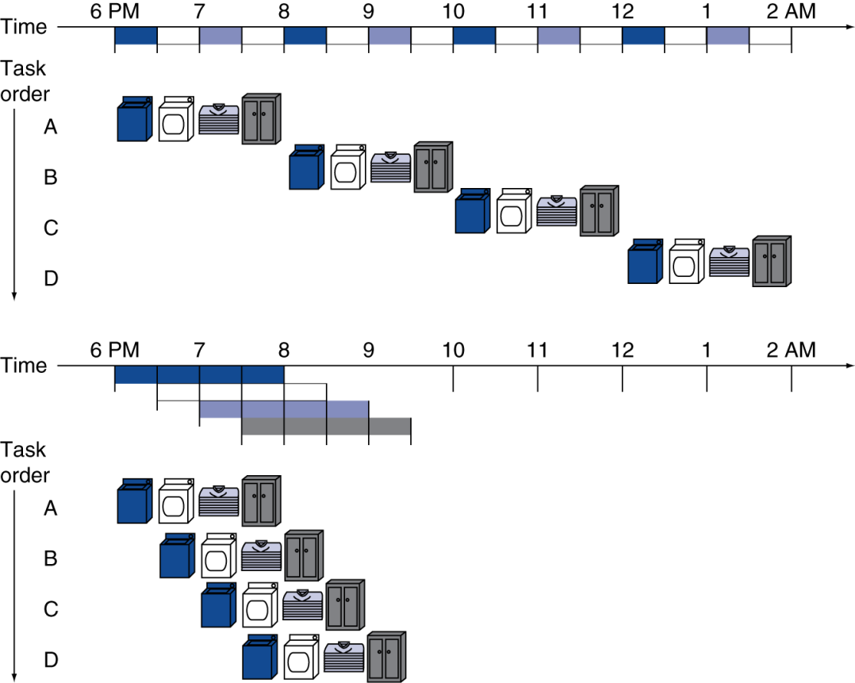
Pipelining Analogy
Pipelined laundry: overlapping execution
  Parallelism improves performance
Four loads:
  Speedup
  = 8/3.5 = 2.3
Non-stop loads:
  Speedup
  = number of stages
  = 4
Chapter 4 — The Processor — <number>
Notes:
Morgan Kaufmann Publishers
Chapter 4 — The Processor

Slide 4
MIPS Pipeline
Five stages, one step per stage
  IF: Instruction fetch from memory
  ID: Instruction decode & register read
  EX: Execute operation or calculate address
  MEM: Access memory operand
  WB: Write result back to register
Chapter 4 — The Processor — <number>
Notes:
Morgan Kaufmann Publishers
Chapter 4 — The Processor

Slide 5
Pipeline Performance
Assume time for stages is
  100ps for register read or write
  200ps for other stages
Compare pipelined datapath with single-cycle datapath
Instr | Instr fetch | Register read | ALU op | Memory access | Register write | Total time
lw | 200ps | 100 ps | 200ps | 200ps | 100 ps | 800ps
sw | 200ps | 100 ps | 200ps | 200ps |  | 700ps
R-format | 200ps | 100 ps | 200ps |  | 100 ps | 600ps
beq | 200ps | 100 ps | 200ps |  |  | 500ps
Chapter 4 — The Processor — <number>
Notes:
Morgan Kaufmann Publishers
Chapter 4 — The Processor

Slide 6
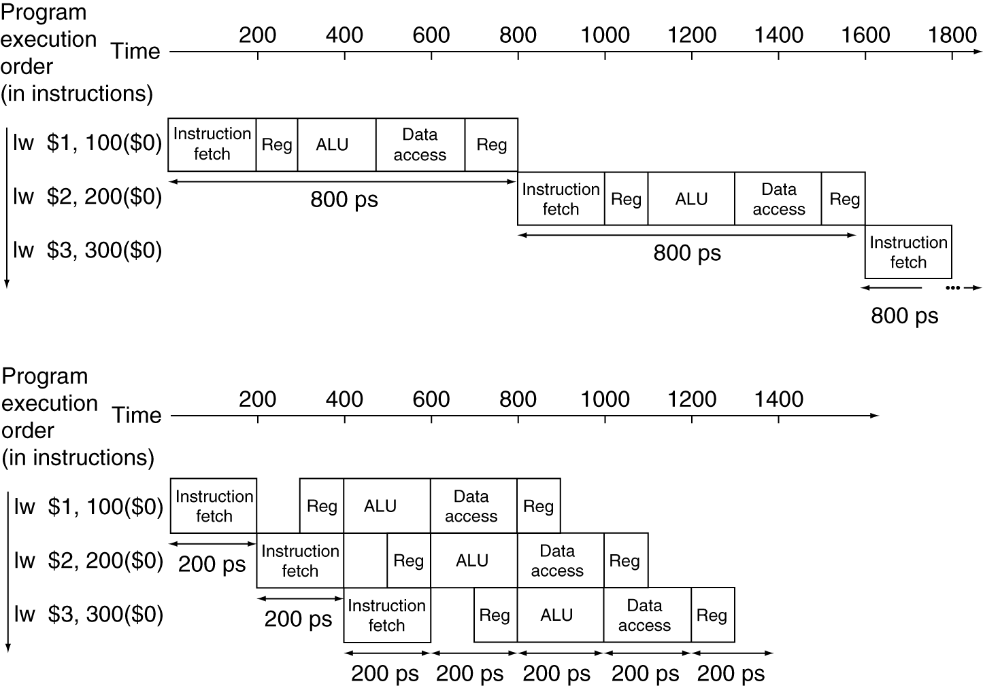
Pipeline Performance
Single-cycle (T_{c}= 800ps)
Pipelined (T_{c}= 200ps)
Chapter 4 — The Processor — <number>
Notes:
Morgan Kaufmann Publishers
Chapter 4 — The Processor

Slide 7
Pipeline Speedup
If all stages are balanced
  i.e., all take the same time
  Time between instructions_{pipelined}
  = Time between instructions_{nonpipelined}
  Number of stages
If not balanced, speedup is less
Speedup due to increased throughput
  Latency (time for each instruction) does not decrease
Chapter 4 — The Processor — <number>
Notes:
Morgan Kaufmann Publishers
Chapter 4 — The Processor

Slide 8
Pipelining and ISA Design
MIPS ISA designed for pipelining
  All instructions are 32-bits
    Easier to fetch and decode in one cycle
    c.f. x86: 1- to 17-byte instructions
  Few and regular instruction formats
    Can decode and read registers in one step
  Load/store addressing
    Can calculate address in 3rd stage, access memory in 4th stage
  Alignment of memory operands
    Memory access takes only one cycle
Chapter 4 — The Processor — <number>
Notes:
Morgan Kaufmann Publishers
Chapter 4 — The Processor

Slide 9
Hazards
Situations that prevent starting the next instruction in the next cycle
Structure hazards
  A required resource is busy
Data hazard
  Need to wait for previous instruction to complete its data read/write
Control hazard
  Deciding on control action depends on previous instruction
Chapter 4 — The Processor — <number>
Notes:
Morgan Kaufmann Publishers
Chapter 4 — The Processor

Slide 10
Structure Hazards
Conflict for use of a resource
In MIPS pipeline with a single memory
  Load/store requires data access
  Instruction fetch would have to stall for that cycle
    Would cause a pipeline “bubble”
Hence, pipelined datapaths require separate instruction/data memories
  Or separate instruction/data caches
Chapter 4 — The Processor — <number>
Notes:
Morgan Kaufmann Publishers
Chapter 4 — The Processor

Slide 11
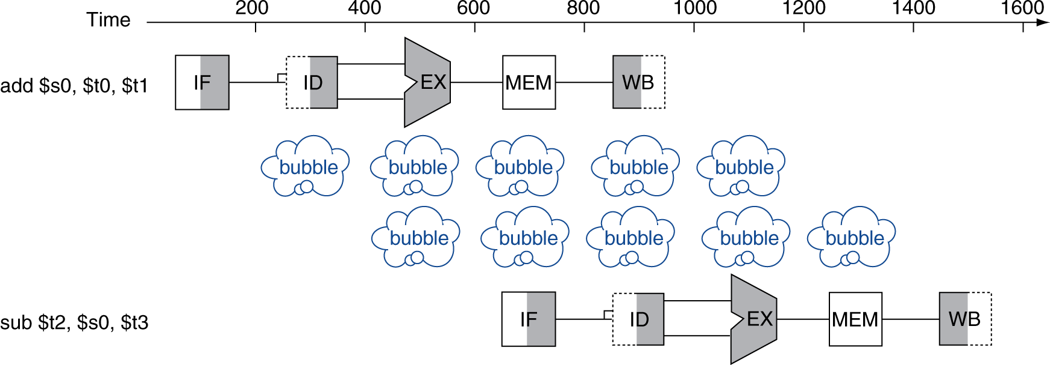
Data Hazards
An instruction depends on completion of data access by a previous instruction
  add $s0, $t0, $t1
  sub $t2, $s0, $t3
  //$s0 has RAW Hazard (Read after write)
  // WAW WAR will not happen on MIPS
Chapter 4 — The Processor — <number>
Notes:
Morgan Kaufmann Publishers
Chapter 4 — The Processor

Slide 12
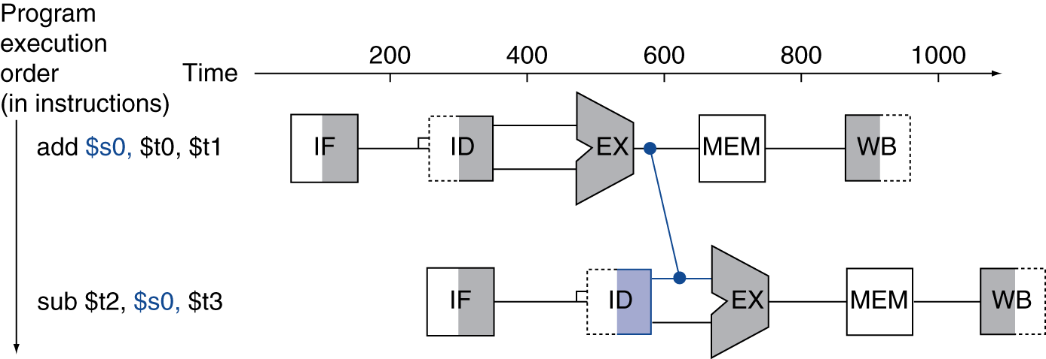
Forwarding (aka Bypassing)
Use result when it is computed
  Don’t wait for it to be stored in a register
  Requires extra connections in the datapath
Chapter 4 — The Processor — <number>
Notes:
Morgan Kaufmann Publishers
Chapter 4 — The Processor

Slide 13
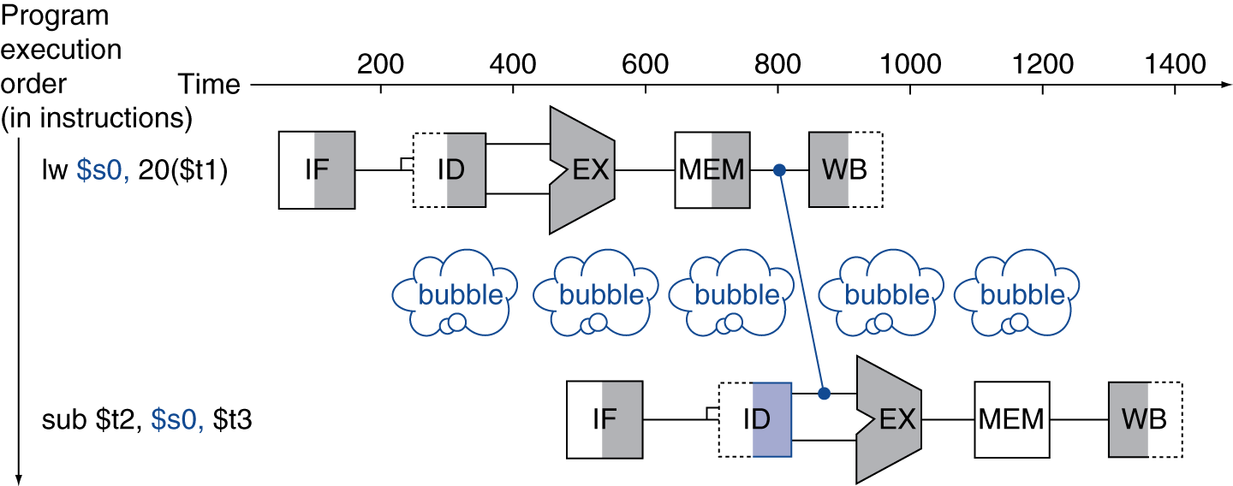
Load-Use Data Hazard
Can’t always avoid stalls by forwarding
  If value not computed when needed
  Can’t forward backward in time!
Chapter 4 — The Processor — <number>
Notes:
Morgan Kaufmann Publishers
Chapter 4 — The Processor

Slide 14
Code Scheduling to Avoid Stalls
Reorder code to avoid use of load result in the next instruction
C code for A = B + E; C = B + F;
lw $t1, 0($t0)
lw $t2, 4($t0)
add $t3, $t1, $t2
sw $t3, 12($t0)
lw $t4, 8($t0)
add $t5, $t1, $t4
sw $t5, 16($t0)
lw $t1, 0($t0)
lw $t2, 4($t0)
lw $t4, 8($t0)
add $t3, $t1, $t2
sw $t3, 12($t0)
add $t5, $t1, $t4
sw $t5, 16($t0)
stall
stall
13 cycles
11 cycles
Chapter 4 — The Processor — <number>
Notes:
Morgan Kaufmann Publishers
Chapter 4 — The Processor

Slide 15
Control Hazards
Branch determines flow of control
  Fetching next instruction depends on branch outcome
  Pipeline can’t always fetch correct instruction
    Still working on ID stage of branch
In MIPS pipeline
  Need to compare registers and compute target early in the pipeline
  Add hardware to do it in ID stage
Chapter 4 — The Processor — <number>
Notes:
Morgan Kaufmann Publishers
Chapter 4 — The Processor

Slide 16
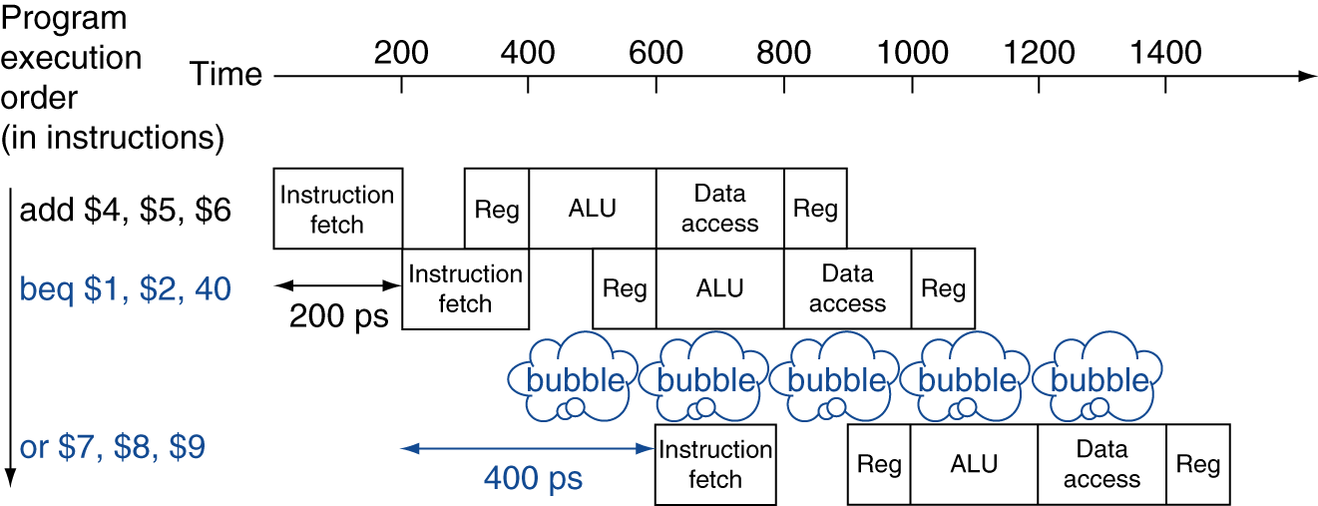
Stall on Branch
Wait until branch outcome determined before fetching next instruction
Chapter 4 — The Processor — <number>
Notes:
Morgan Kaufmann Publishers
Chapter 4 — The Processor

Slide 17
Branch Prediction
Longer pipelines can’t readily determine branch outcome early
  Stall penalty becomes unacceptable
Predict outcome of branch
  Only stall if prediction is wrong
In MIPS pipeline
  Can predict branches not taken
  Fetch instruction after branch, with no delay
Chapter 4 — The Processor — <number>
Notes:
Morgan Kaufmann Publishers
Chapter 4 — The Processor

Slide 18
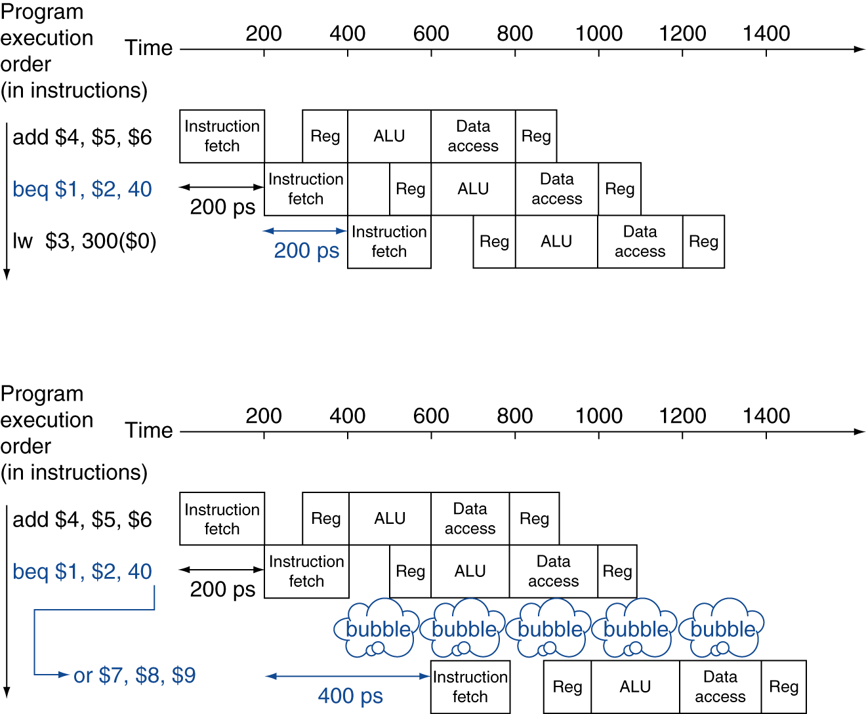
MIPS with Predict Not Taken
Prediction correct
Prediction incorrect
Chapter 4 — The Processor — <number>
Notes:
Morgan Kaufmann Publishers
Chapter 4 — The Processor

Slide 19
More-Realistic Branch Prediction
Static branch prediction
  Based on typical branch behavior
  Example: loop and if-statement branches
    Predict backward branches taken
    Predict forward branches not taken
Dynamic branch prediction
  Hardware measures actual branch behavior
    e.g., record recent history of each branch
  Assume future behavior will continue the trend
    When wrong, stall while re-fetching, and update history
Chapter 4 — The Processor — <number>
Notes:
Morgan Kaufmann Publishers
Chapter 4 — The Processor

Slide 20
Instruction-Level Parallelism (ILP)
Pipelining: executing multiple instructions in parallel
To increase ILP
  Deeper pipeline
    Less work per stage ⇒ shorter clock cycle
  Multiple issue
    Replicate pipeline stages ⇒ multiple pipelines
    Start multiple instructions per clock cycle
    CPI < 1, so use Instructions Per Cycle (IPC)
    E.g., 4GHz 4-way multiple-issue
      16 BIPS, peak CPI = 0.25, peak IPC = 4
    But dependencies reduce this in practice
§4.10 Parallelism via Instructions
Chapter 4 — The Processor — <number>
Notes:
Morgan Kaufmann Publishers
Chapter 4 — The Processor

Slide 21
Multiple Issue
Static multiple issue
  Compiler groups instructions to be issued together
  Packages them into “issue slots”
  Compiler detects and avoids hazards
Dynamic multiple issue
  CPU examines instruction stream and chooses instructions to issue each cycle
  Compiler can help by reordering instructions
  CPU resolves hazards using advanced techniques at runtime
Chapter 4 — The Processor — <number>
Notes:
Morgan Kaufmann Publishers
Chapter 4 — The Processor

Slide 22
Speculation
“Guess” what to do with an instruction
  Start operation as soon as possible
  Check whether guess was right
    If so, complete the operation
    If not, roll-back and do the right thing
Common to static and dynamic multiple issue
Examples
  Speculate on branch outcome
    Roll back if path taken is different
  Speculate on load
    Roll back if location is updated
Chapter 4 — The Processor — <number>
Notes:
Morgan Kaufmann Publishers
Chapter 4 — The Processor

Slide 23
Compiler/Hardware Speculation
Compiler can reorder instructions
  e.g., move load before branch
  Can include “fix-up” instructions to recover from incorrect guess
Hardware can look ahead for instructions to execute
  Buffer results until it determines they are actually needed
  Flush buffers on incorrect speculation
Chapter 4 — The Processor — <number>
Notes:
Morgan Kaufmann Publishers
Chapter 4 — The Processor

Slide 24
Speculation and Exceptions
What if exception occurs on a speculatively executed instruction?
  e.g., speculative load before null-pointer check
Static speculation
  Can add ISA support for deferring exceptions
Dynamic speculation
  Can buffer exceptions until instruction completion (which may not occur)
Chapter 4 — The Processor — <number>
Notes:
Morgan Kaufmann Publishers
Chapter 4 — The Processor

Slide 25
Static Multiple Issue
Compiler groups instructions into “issue packets”
  Group of instructions that can be issued on a single cycle
  Determined by pipeline resources required
Think of an issue packet as a very long instruction
  Specifies multiple concurrent operations
  ⇒ Very Long Instruction Word (VLIW)
Chapter 4 — The Processor — <number>
Notes:
Morgan Kaufmann Publishers
Chapter 4 — The Processor

Slide 26
Scheduling Static Multiple Issue
Compiler must remove some/all hazards
  Reorder instructions into issue packets
  No dependencies with a packet
  Possibly some dependencies between packets
    Varies between ISAs; compiler must know!
  Pad with nop if necessary
Chapter 4 — The Processor — <number>
Notes:
Morgan Kaufmann Publishers
Chapter 4 — The Processor

Slide 27
MIPS with Static Dual Issue
Two-issue packets
  One ALU/branch instruction
  One load/store instruction
  64-bit aligned
    ALU/branch, then load/store
    Pad an unused instruction with nop
Address | Instruction type | Pipeline Stages
n | ALU/branch | IF | ID | EX | MEM | WB
n + 4 | Load/store | IF | ID | EX | MEM | WB
n + 8 | ALU/branch |  | IF | ID | EX | MEM | WB
n + 12 | Load/store |  | IF | ID | EX | MEM | WB
n + 16 | ALU/branch |  |  | IF | ID | EX | MEM | WB
n + 20 | Load/store |  |  | IF | ID | EX | MEM | WB
Chapter 4 — The Processor — <number>
Notes:
Morgan Kaufmann Publishers
Chapter 4 — The Processor

Slide 28
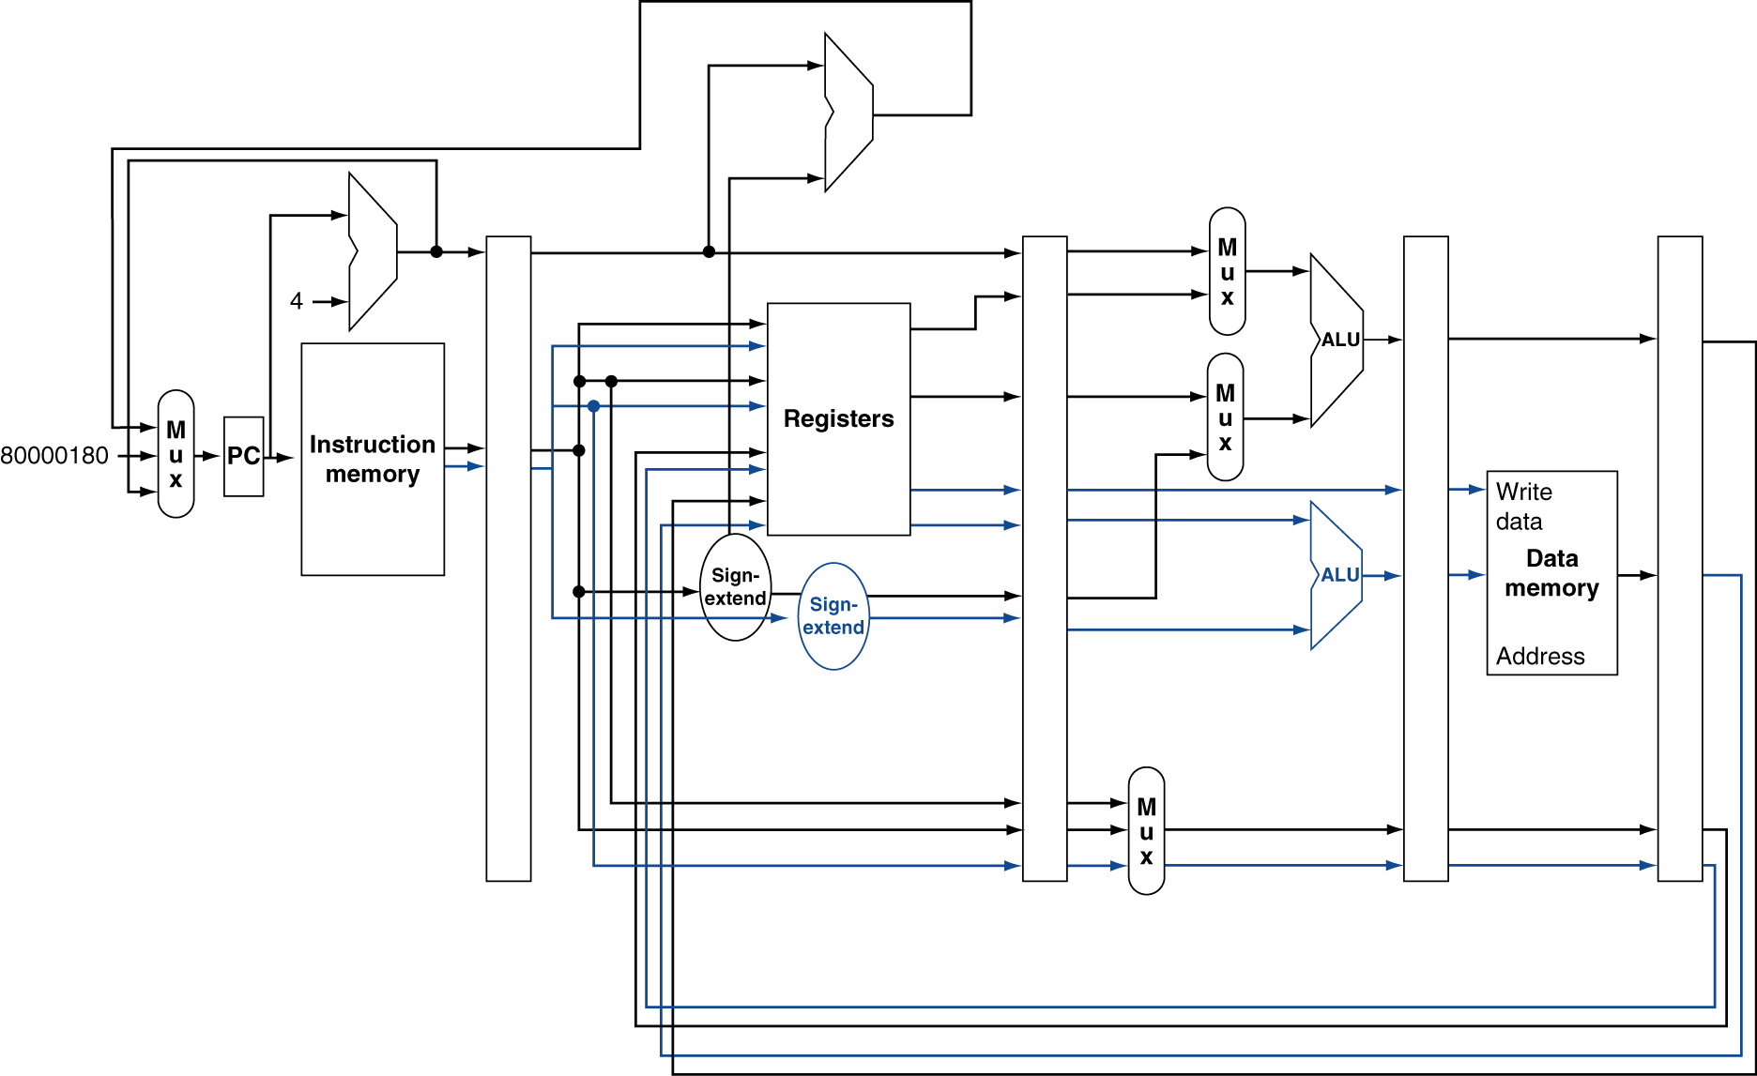
MIPS with Static Dual Issue
Chapter 4 — The Processor — <number>
Notes:
Morgan Kaufmann Publishers
Chapter 4 — The Processor

Slide 29
Hazards in the Dual-Issue MIPS
More instructions executing in parallel
EX data hazard
  Forwarding avoided stalls with single-issue
  Now can’t use ALU result in load/store in same packet
    add $t0, $s0, $s1
    load $s2, 0($t0)
    Split into two packets, effectively a stall
Load-use hazard
  Still one cycle use latency, but now two instructions
More aggressive scheduling required
Chapter 4 — The Processor — <number>
Notes:
Morgan Kaufmann Publishers
Chapter 4 — The Processor

Slide 30
Scheduling Example
Schedule this for dual-issue MIPS
Loop: lw $t0, 0($s1) # $t0=array element
addu $t0, $t0, $s2 # add scalar in $s2
sw $t0, 0($s1) # store result
addi $s1, $s1,–4 # decrement pointer
bne $s1, $zero, Loop # branch $s1!=0
 | ALU/branch | Load/store | cycle
Loop: | nop | lw $t0, 0($s1) | 1
 | addi $s1, $s1,–4 | nop | 2
 | addu $t0, $t0, $s2 | nop | 3
 | bne $s1, $zero, Loop | sw $t0, 4($s1) | 4
  IPC = 5/4 = 1.25 (c.f. peak IPC = 2)
Chapter 4 — The Processor — <number>
Notes:
Morgan Kaufmann Publishers
Chapter 4 — The Processor

Slide 31
Loop Unrolling
Replicate loop body to expose more parallelism
  Reduces loop-control overhead
Use different registers per replication
  Called “register renaming”
  Avoid loop-carried “anti-dependencies”
    Store followed by a load of the same register
    Aka “name dependence”
      Reuse of a register name
Chapter 4 — The Processor — <number>
Notes:
Morgan Kaufmann Publishers
Chapter 4 — The Processor

Slide 32
Loop Unrolling Example
 | ALU/branch | Load/store | cycle
Loop: | addi $s1, $s1,–16 | lw $t0, 0($s1) | 1
 | nop | lw $t1, 12($s1) | 2
 | addu $t0, $t0, $s2 | lw $t2, 8($s1) | 3
 | addu $t1, $t1, $s2 | lw $t3, 4($s1) | 4
 | addu $t2, $t2, $s2 | sw $t0, 16($s1) | 5
 | addu $t3, $t4, $s2 | sw $t1, 12($s1) | 6
 | nop | sw $t2, 8($s1) | 7
 | bne $s1, $zero, Loop | sw $t3, 4($s1) | 8
IPC = 14/8 = 1.75
  Closer to 2, but at cost of registers and code size
Chapter 4 — The Processor — <number>
Notes:
Morgan Kaufmann Publishers
Chapter 4 — The Processor

Slide 33
Dynamic Multiple Issue
“Superscalar” processors
CPU decides whether to issue 0, 1, 2, … each cycle
  Avoiding structural and data hazards
Avoids the need for compiler scheduling
  Though it may still help
  Code semantics ensured by the CPU
Chapter 4 — The Processor — <number>
Notes:
Morgan Kaufmann Publishers
Chapter 4 — The Processor

Slide 34
Dynamic Pipeline Scheduling
Allow the CPU to execute instructions out of order to avoid stalls
  But commit result to registers in order
Example
  lw $t0, 20($s2)
  addu $t1, $t0, $t2
  sub $s4, $s4, $t3
  slti $t5, $s4, 20
  Can start sub while addu is waiting for lw
Chapter 4 — The Processor — <number>
Notes:
Morgan Kaufmann Publishers
Chapter 4 — The Processor

Slide 35
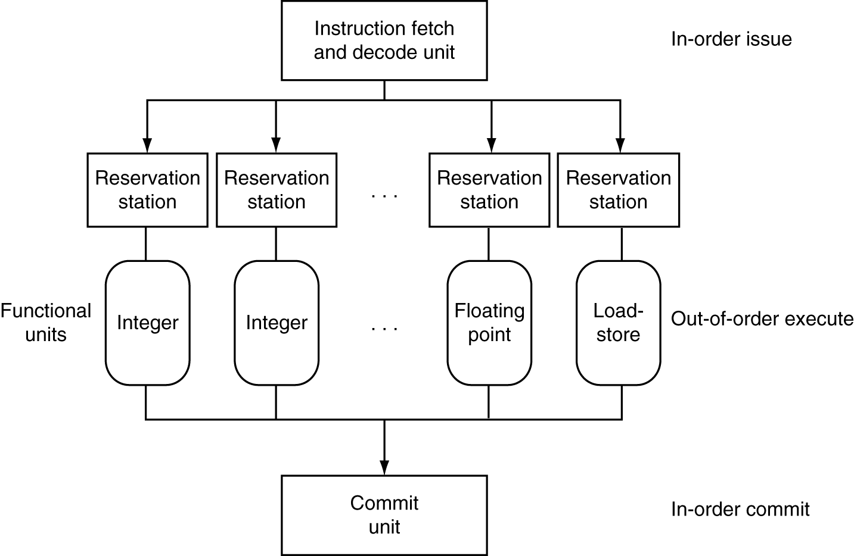
Dynamically Scheduled CPU
Preserves dependencies
Hold pending operands
Results also sent to any waiting reservation stations
Reorders buffer for register writes
Can supply operands for issued instructions
Chapter 4 — The Processor — <number>
Notes:
Morgan Kaufmann Publishers
Chapter 4 — The Processor

Slide 36
Register Renaming
Reservation stations and reorder buffer effectively provide register renaming
On instruction issue to reservation station
  If operand is available in register file or reorder buffer
    Copied to reservation station
    No longer required in the register; can be overwritten
  If operand is not yet available
    It will be provided to the reservation station by a function unit
    Register update may not be required
Chapter 4 — The Processor — <number>
Notes:
Morgan Kaufmann Publishers
Chapter 4 — The Processor

Slide 37
Speculation
Predict branch and continue issuing
  Don’t commit until branch outcome determined
Load speculation
  Avoid load and cache miss delay
    Predict the effective address
    Predict loaded value
    Load before completing outstanding stores
    Bypass stored values to load unit
  Don’t commit load until speculation cleared
Chapter 4 — The Processor — <number>
Notes:
Morgan Kaufmann Publishers
Chapter 4 — The Processor

Slide 38
Why Do Dynamic Scheduling?
Why not just let the compiler schedule code?
Not all stalls are predicable
  e.g., cache misses
Can’t always schedule around branches
  Branch outcome is dynamically determined
Different implementations of an ISA have different latencies and hazards
Chapter 4 — The Processor — <number>
Notes:
Morgan Kaufmann Publishers
Chapter 4 — The Processor

Slide 39
Does Multiple Issue Work?
Yes, but not as much as we’d like
Programs have real dependencies that limit ILP
Some dependencies are hard to eliminate
  e.g., pointer aliasing
Some parallelism is hard to expose
  Limited window size during instruction issue
Memory delays and limited bandwidth
  Hard to keep pipelines full
Speculation can help if done well
Chapter 4 — The Processor — <number>
Notes:
Morgan Kaufmann Publishers
Chapter 4 — The Processor

Slide 40
Power Efficiency
Complexity of dynamic scheduling and speculations requires power
Multiple simpler cores may be better
Microprocessor | Year | Clock Rate | Pipeline Stages | Issue width | Out-of-order/ Speculation | Cores | Power
i486 | 1989 | 25MHz | 5 | 1 | No | 1 | 5W
Pentium | 1993 | 66MHz | 5 | 2 | No | 1 | 10W
Pentium Pro | 1997 | 200MHz | 10 | 3 | Yes | 1 | 29W
P4 Willamette | 2001 | 2000MHz | 22 | 3 | Yes | 1 | 75W
P4 Prescott | 2004 | 3600MHz | 31 | 3 | Yes | 1 | 103W
Core | 2006 | 2930MHz | 14 | 4 | Yes | 2 | 75W
UltraSparc III | 2003 | 1950MHz | 14 | 4 | No | 1 | 90W
UltraSparc T1 | 2005 | 1200MHz | 6 | 1 | No | 8 | 70W
Chapter 4 — The Processor — <number>
Notes:
Morgan Kaufmann Publishers
Chapter 4 — The Processor

Slide 41
Cortex A8 and Intel i7
Processor | ARM A8 | Intel Core i7 920
Market | Personal Mobile Device | Server, cloud
Thermal design power | 2 Watts | 130 Watts
Clock rate | 1 GHz | 2.66 GHz
Cores/Chip | 1 | 4
Floating point? | No | Yes
Multiple issue? | Dynamic | Dynamic
Peak instructions/clock cycle | 2 | 4
Pipeline stages | 14 | 14
Pipeline schedule | Static in-order | Dynamic out-of-order with speculation
Branch prediction | 2-level | 2-level
1st level caches/core | 32 KiB I, 32 KiB D | 32 KiB I, 32 KiB D
2nd level caches/core | 128-1024 KiB | 256 KiB
3rd level caches (shared) | - | 2- 8 MB
§4.11 Real Stuff: The ARM Cortex-A8 and Intel Core i7 Pipelines
Chapter 4 — The Processor — <number>

Slide 42
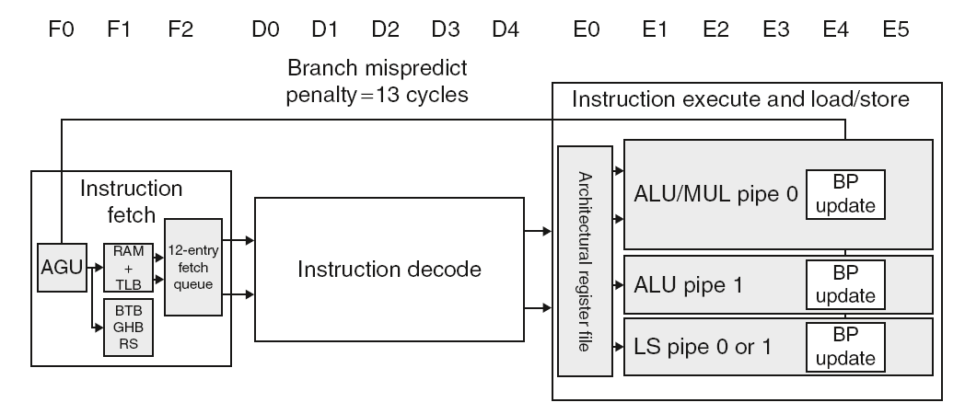
ARM Cortex-A8 Pipeline
Chapter 4 — The Processor — <number>

Slide 43
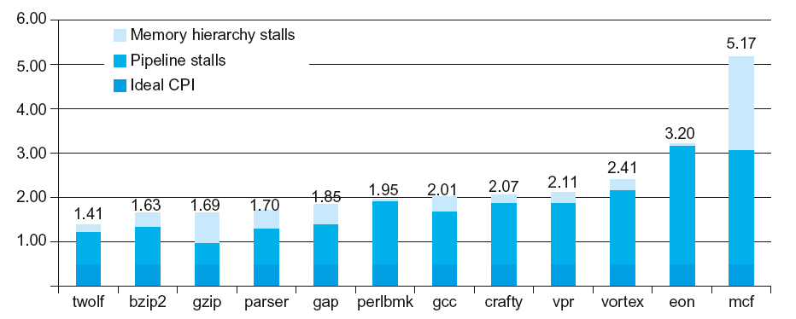
ARM Cortex-A8 Performance
Chapter 4 — The Processor — <number>

Slide 44
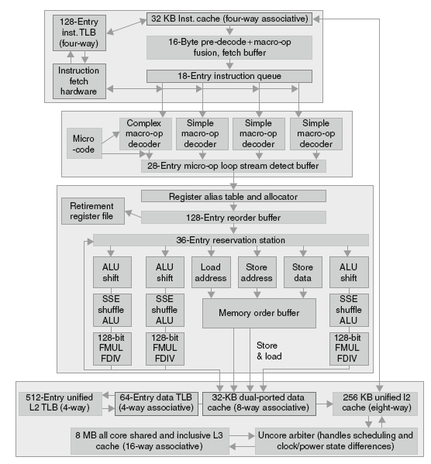
Core i7
Pipeline
Chapter 4 — The Processor — <number>

Slide 45
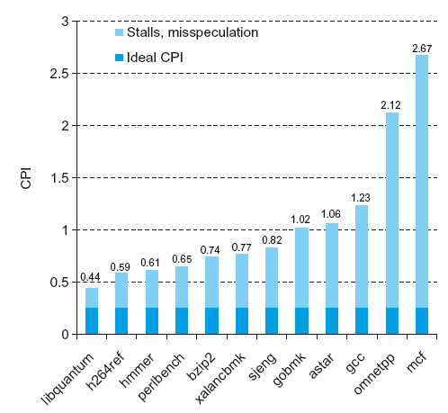
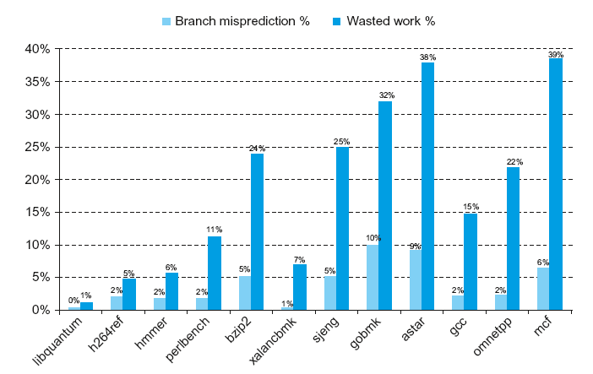
Core i7 Performance
Chapter 4 — The Processor — <number>

Slide 46
Fallacies
Pipelining is easy (!)
  The basic idea is easy
  The devil is in the details
    e.g., detecting data hazards
Pipelining is independent of technology
  So why haven’t we always done pipelining?
  More transistors make more advanced techniques feasible
  Pipeline-related ISA design needs to take account of technology trends
    e.g., predicated instructions
Chapter 4 — The Processor — <number>
Notes:
Morgan Kaufmann Publishers
Chapter 4 — The Processor

Slide 47
Pitfalls
Poor ISA design can make pipelining harder
  e.g., complex instruction sets (VAX, IA-32)
    Significant overhead to make pipelining work
    IA-32 micro-op approach
  e.g., complex addressing modes
    Register update side effects, memory indirection
  e.g., delayed branches
    Advanced pipelines have long delay slots
Chapter 4 — The Processor — <number>
Notes:
Morgan Kaufmann Publishers
Chapter 4 — The Processor

Slide 48
Concluding Remarks
ISA influences design of datapath and control
Datapath and control influence design of ISA
Pipelining improves instruction throughput
using parallelism
  More instructions completed per second
  Latency for each instruction not reduced
Hazards: structural, data, control
Multiple issue and dynamic scheduling (ILP)
  Dependencies limit achievable parallelism
  Complexity leads to the power wall
Chapter 4 — The Processor — <number>
Notes:
Morgan Kaufmann Publishers
Chapter 4 — The Processor

Slide 49

Additional Slides 4.6
Chapter 4 — The Processor — <number>

Slide 50
Pipeline Summary
The BIG Picture
Pipelining improves performance by increasing instruction throughput
  Executes multiple instructions in parallel
  Each instruction has the same latency
Subject to hazards
  Structure, data, control
Instruction set design affects complexity of pipeline implementation
Chapter 4 — The Processor — <number>
Notes:
Morgan Kaufmann Publishers
Chapter 4 — The Processor

Slide 51
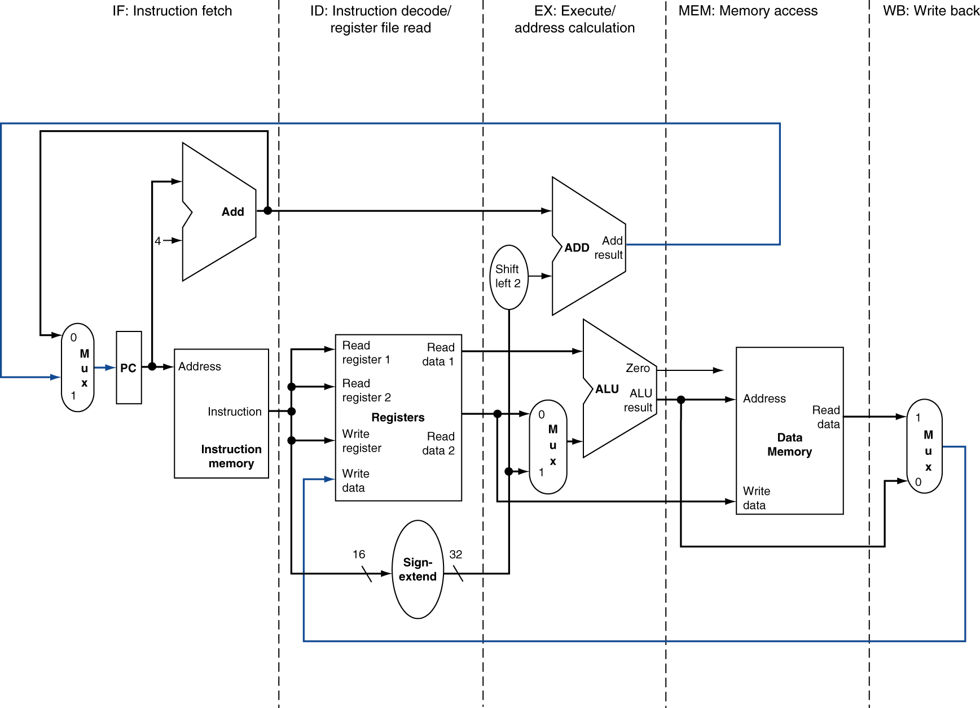
MIPS Pipelined Datapath
Right-to-left flow leads to hazards
WB
Chapter 4 — The Processor — <number>
Notes:
Morgan Kaufmann Publishers
Chapter 4 — The Processor

Slide 52
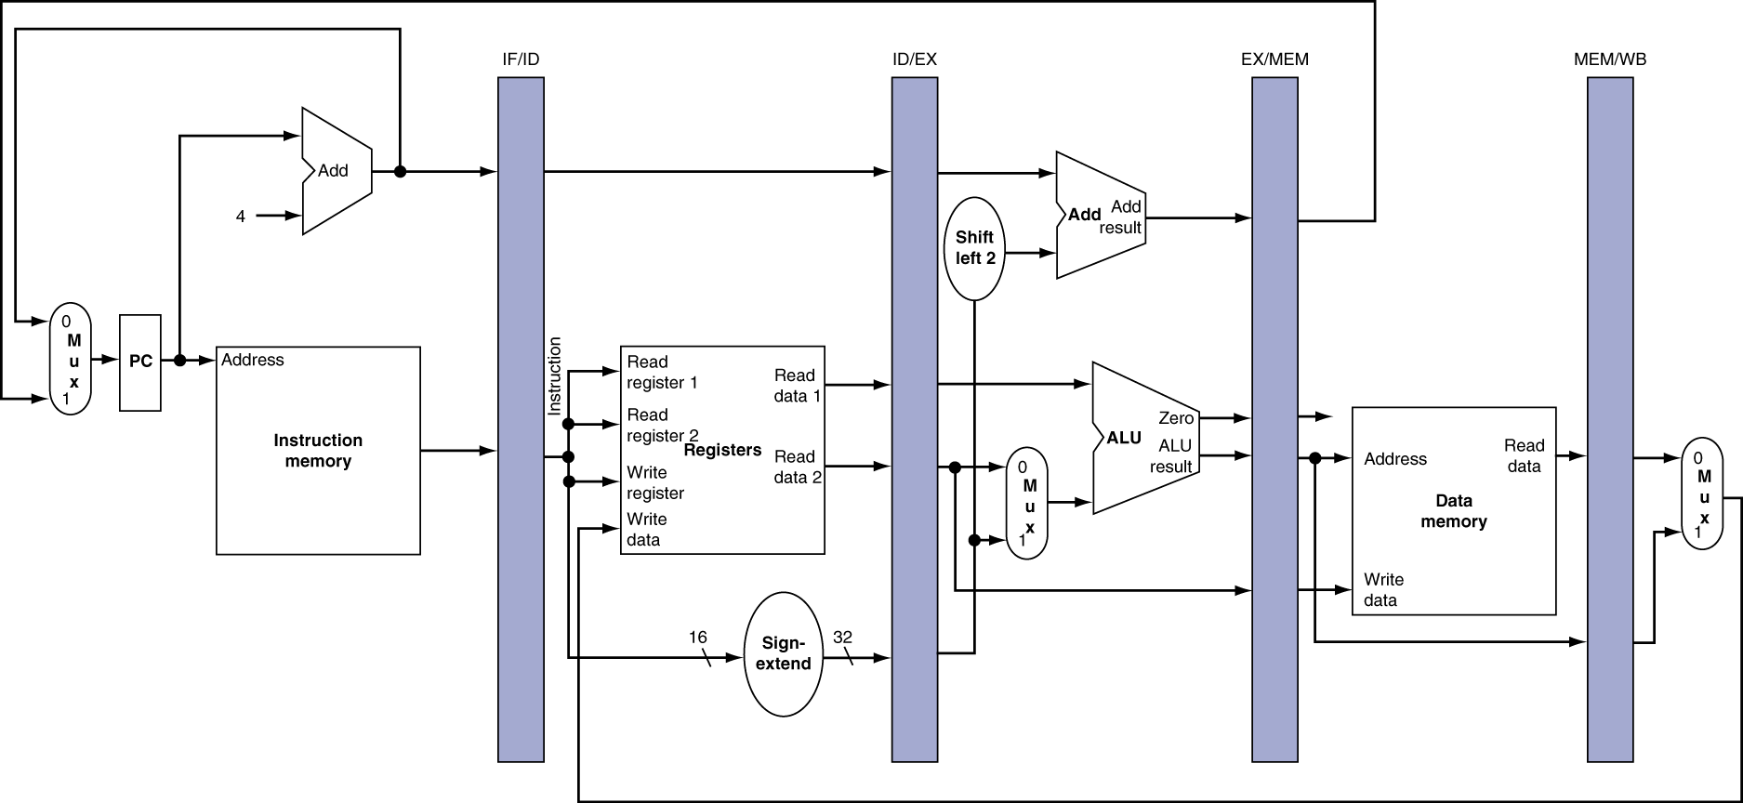
Pipeline registers
Need registers between stages
  To hold information produced in previous cycle
Chapter 4 — The Processor — <number>
Notes:
Morgan Kaufmann Publishers
Chapter 4 — The Processor

Slide 53
Pipeline Operation
Cycle-by-cycle flow of instructions through the pipelined datapath
  “Single-clock-cycle” pipeline diagram
    Shows pipeline usage in a single cycle
    Highlight resources used
  c.f. “multi-clock-cycle” diagram
    Graph of operation over time
We’ll look at “single-clock-cycle” diagrams for load & store
Chapter 4 — The Processor — <number>
Notes:
Morgan Kaufmann Publishers
Chapter 4 — The Processor

Slide 54
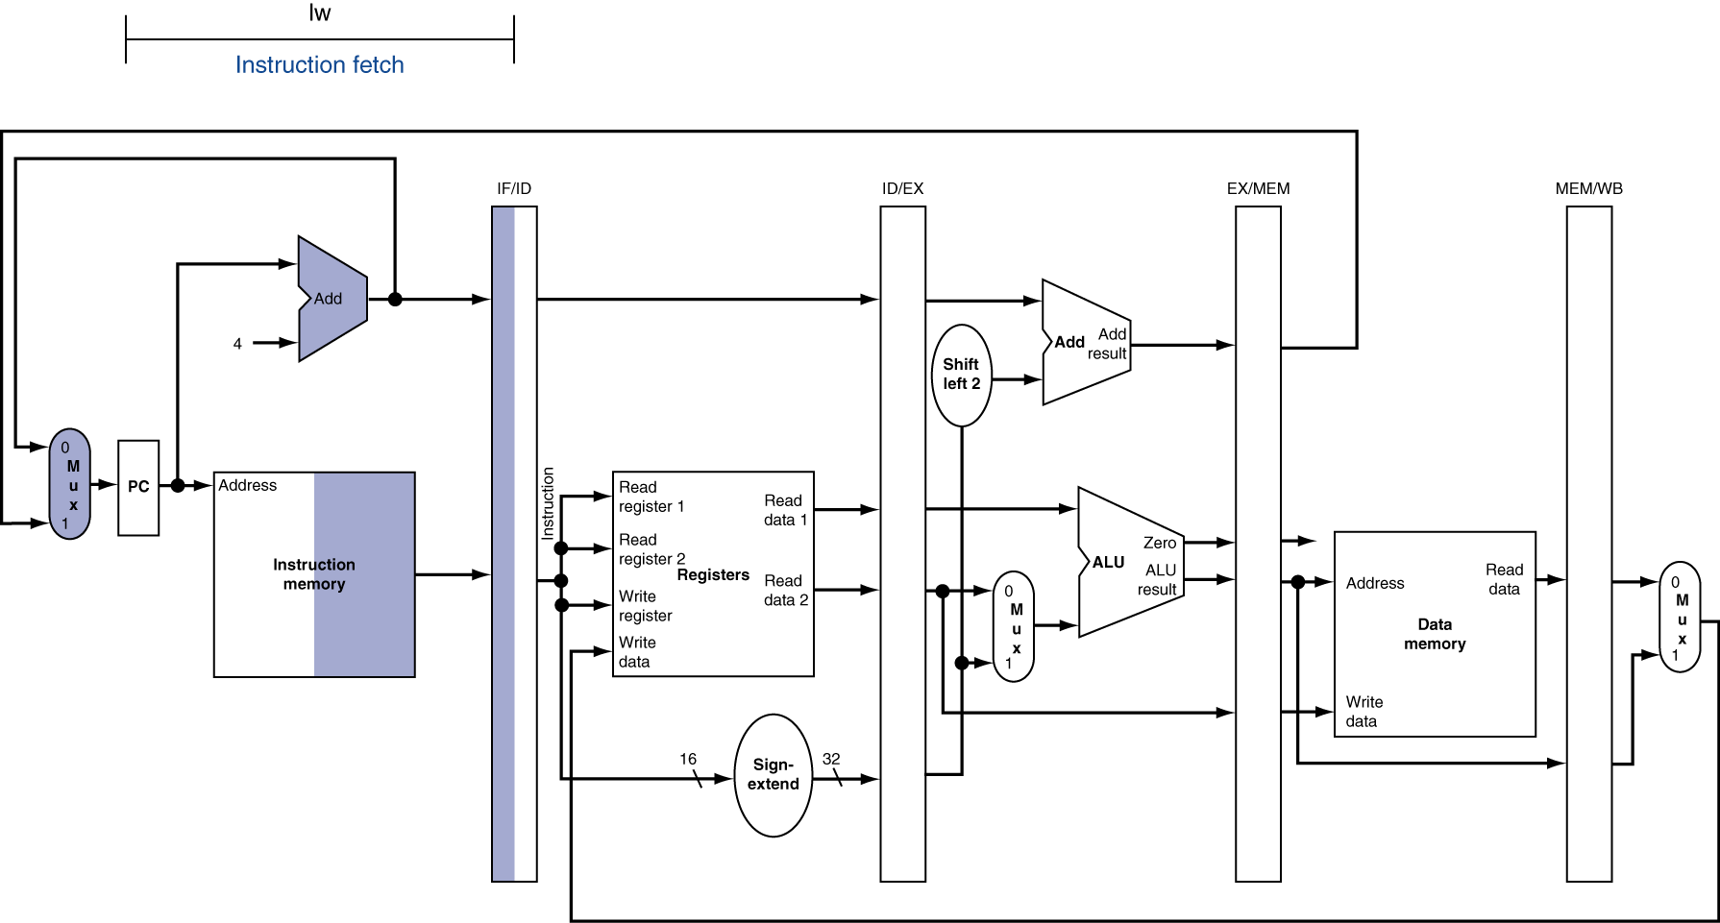
IF for Load, Store, …
Chapter 4 — The Processor — <number>
Notes:
Morgan Kaufmann Publishers
Chapter 4 — The Processor

Slide 55
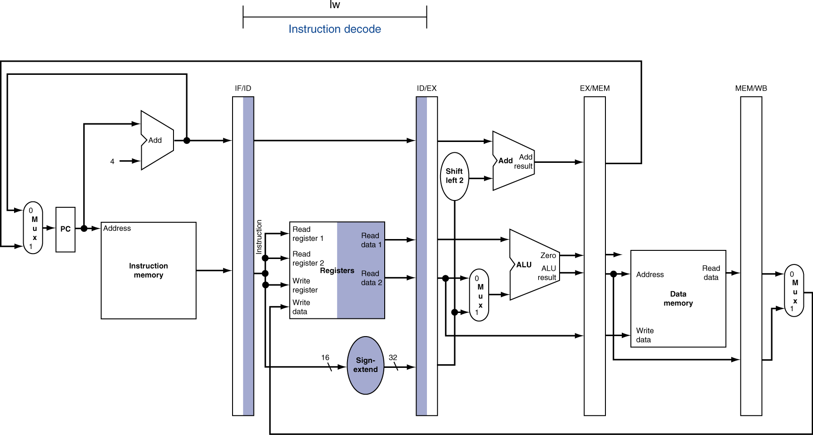
ID for Load, Store, …
Chapter 4 — The Processor — <number>
Notes:
Morgan Kaufmann Publishers
Chapter 4 — The Processor

Slide 56
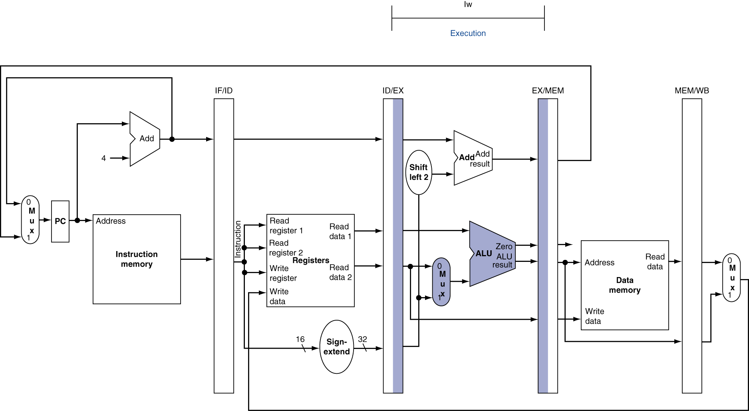
EX for Load
Chapter 4 — The Processor — <number>
Notes:
Morgan Kaufmann Publishers
Chapter 4 — The Processor

Slide 57
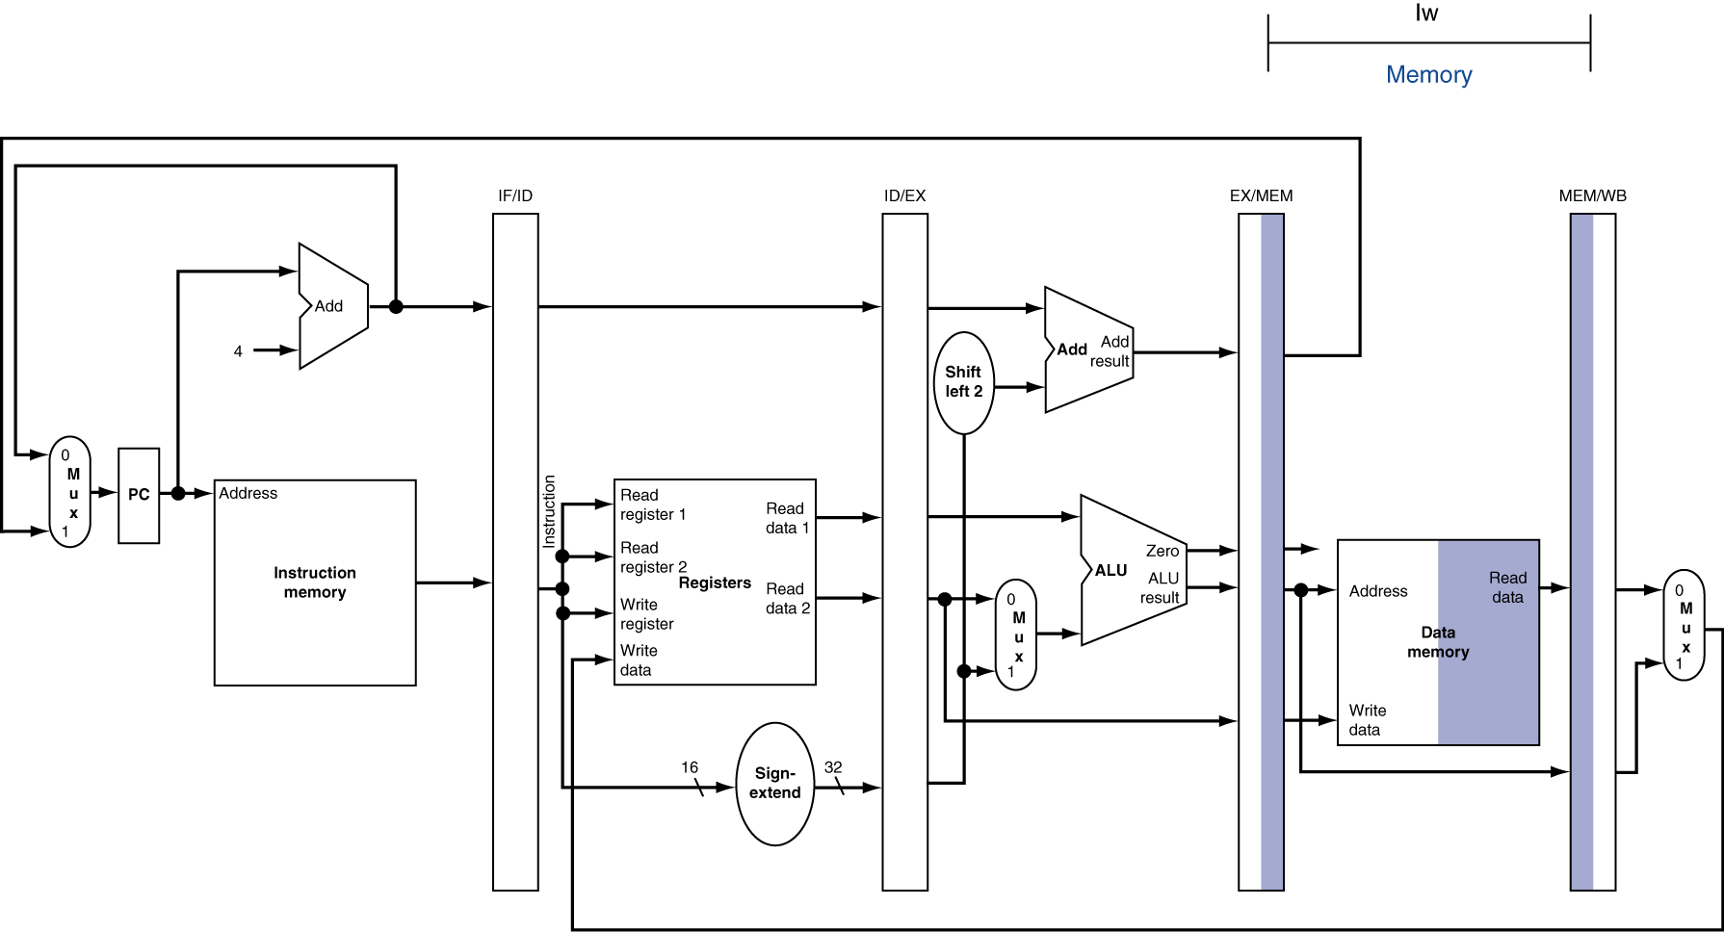
MEM for Load
Chapter 4 — The Processor — <number>
Notes:
Morgan Kaufmann Publishers
Chapter 4 — The Processor

Slide 58
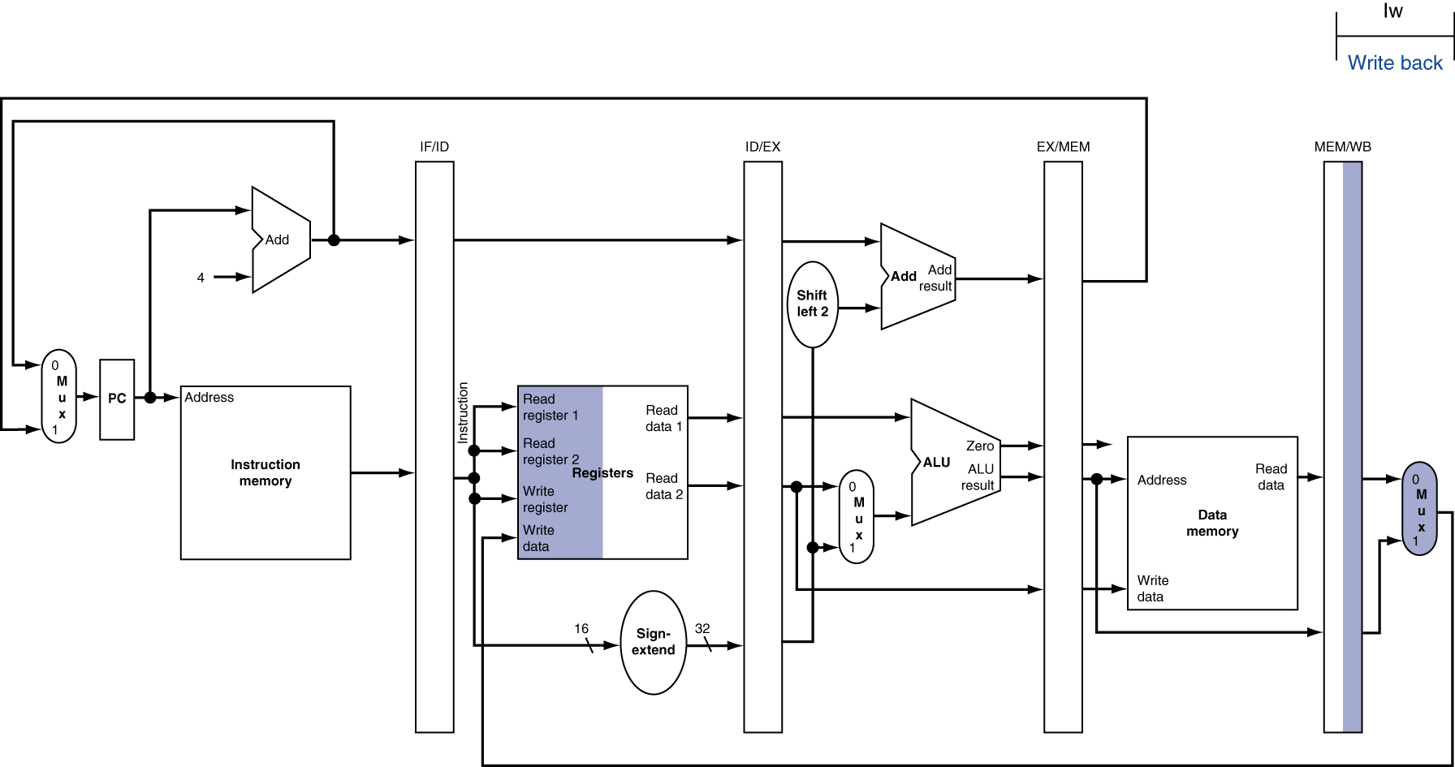
WB for Load
Wrong
register
number
Chapter 4 — The Processor — <number>
Notes:
Morgan Kaufmann Publishers
Chapter 4 — The Processor

Slide 59
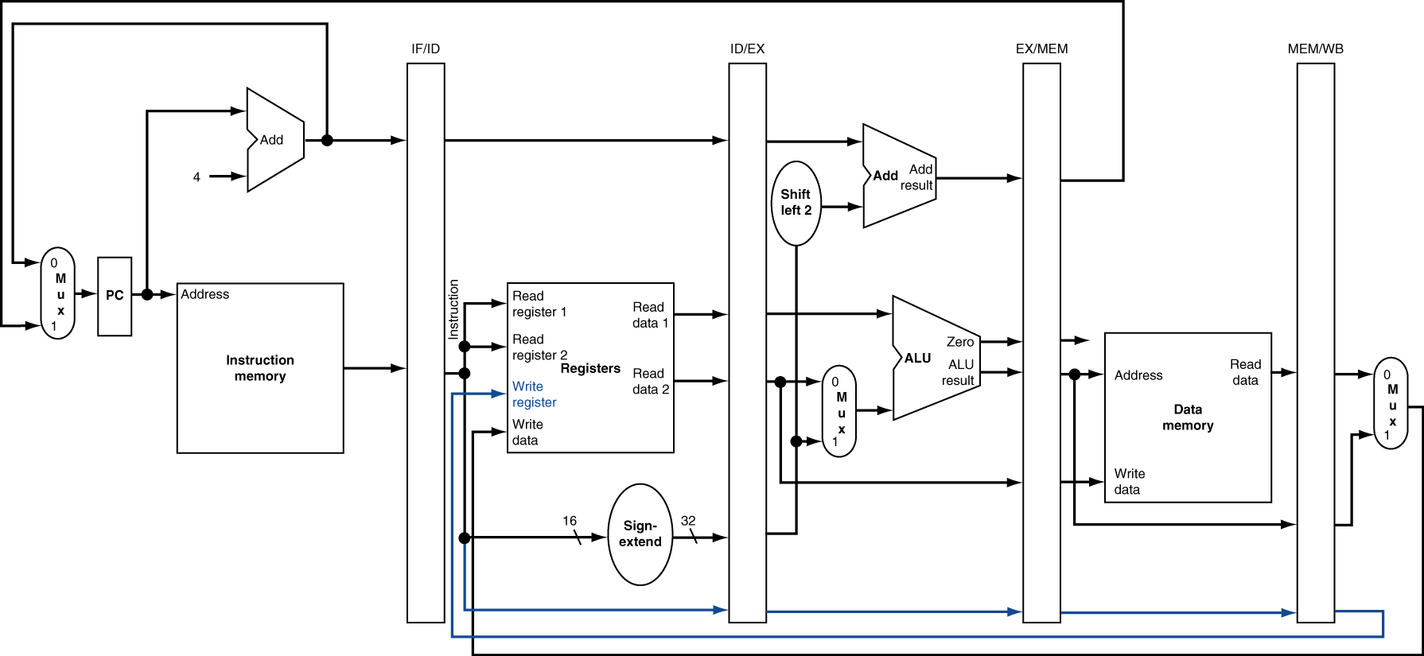
Corrected Datapath for Load
Chapter 4 — The Processor — <number>
Notes:
Morgan Kaufmann Publishers
Chapter 4 — The Processor

Slide 60

EX for Store
Chapter 4 — The Processor — <number>
Notes:
Morgan Kaufmann Publishers
Chapter 4 — The Processor

Slide 61
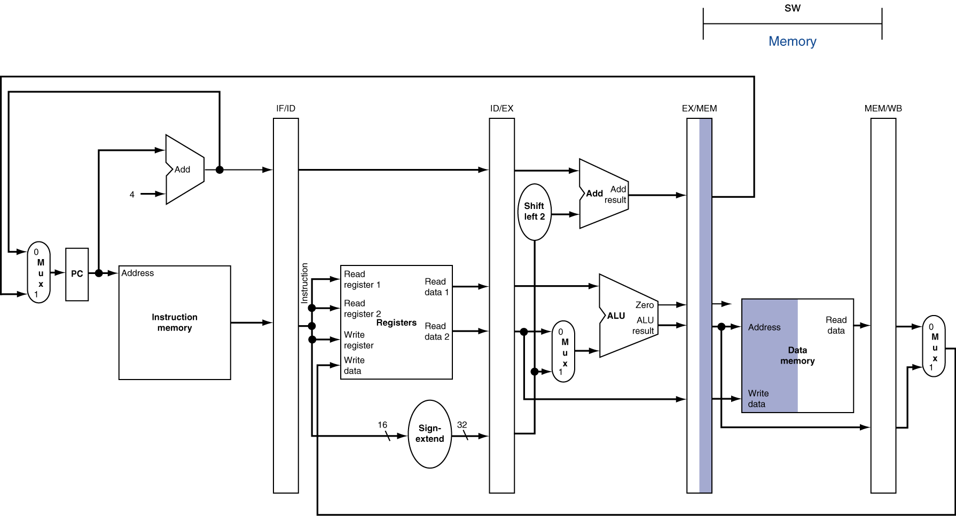
MEM for Store
Chapter 4 — The Processor — <number>
Notes:
Morgan Kaufmann Publishers
Chapter 4 — The Processor

Slide 62
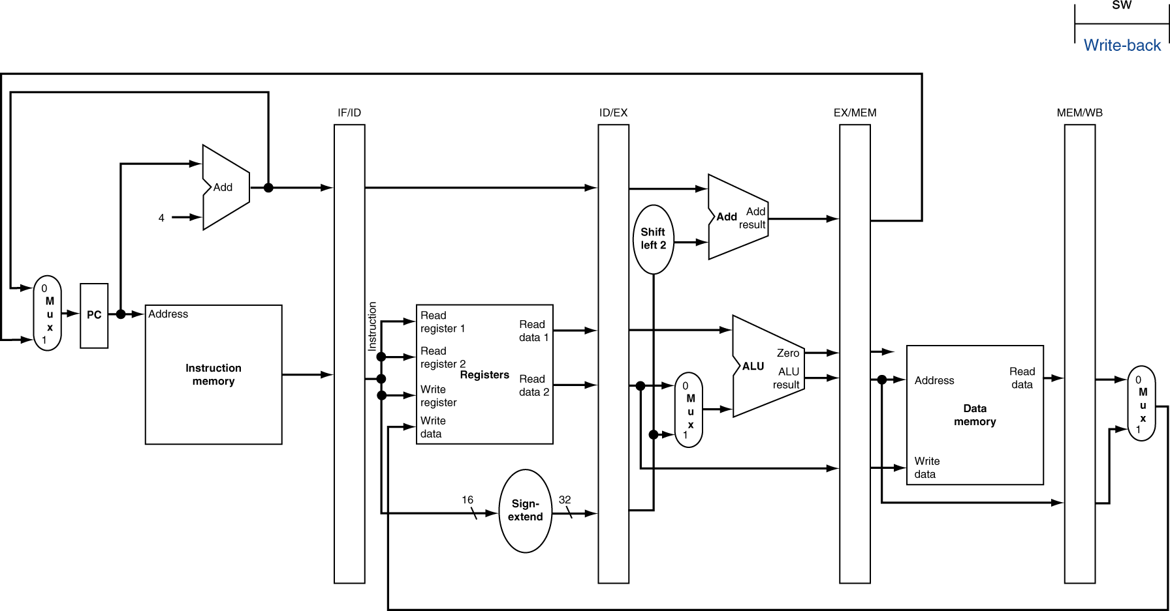
WB for Store
Chapter 4 — The Processor — <number>
Notes:
Morgan Kaufmann Publishers
Chapter 4 — The Processor

Slide 63
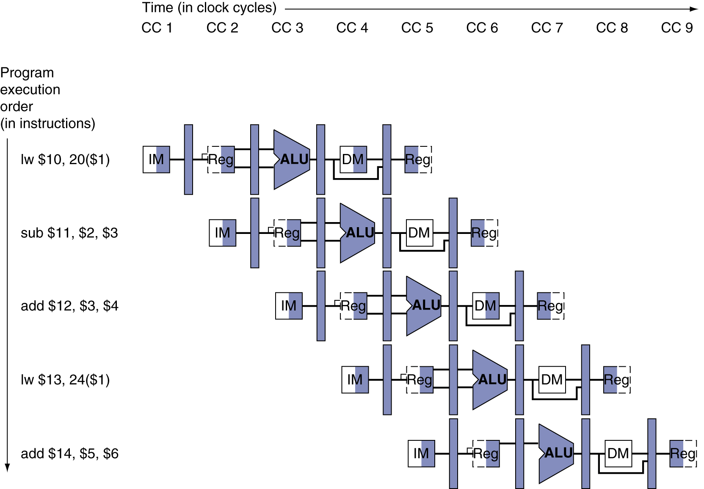
Multi-Cycle Pipeline Diagram
Form showing resource usage
Chapter 4 — The Processor — <number>
Notes:
Morgan Kaufmann Publishers
Chapter 4 — The Processor

Slide 64
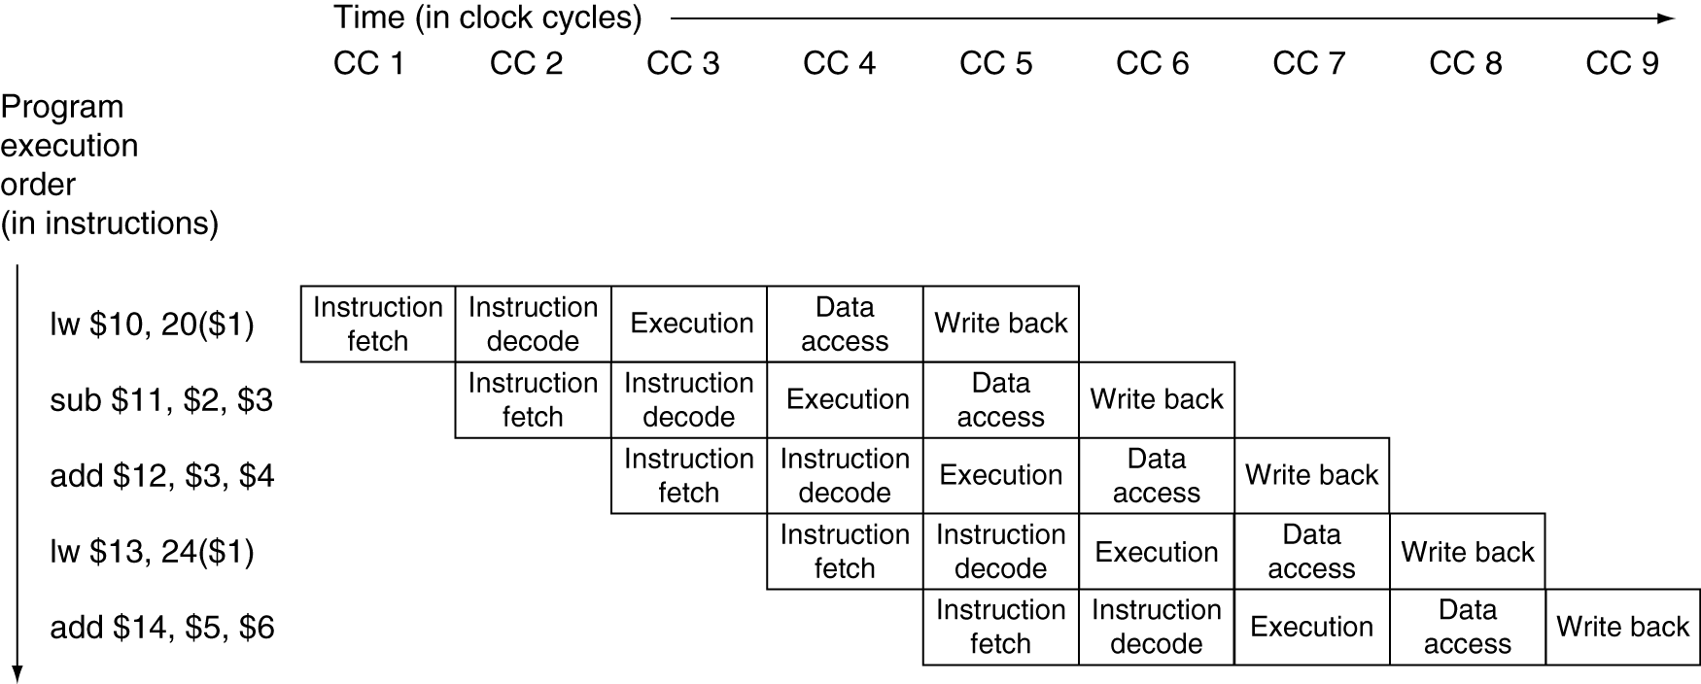
Multi-Cycle Pipeline Diagram
Traditional form
Chapter 4 — The Processor — <number>
Notes:
Morgan Kaufmann Publishers
Chapter 4 — The Processor

Slide 65
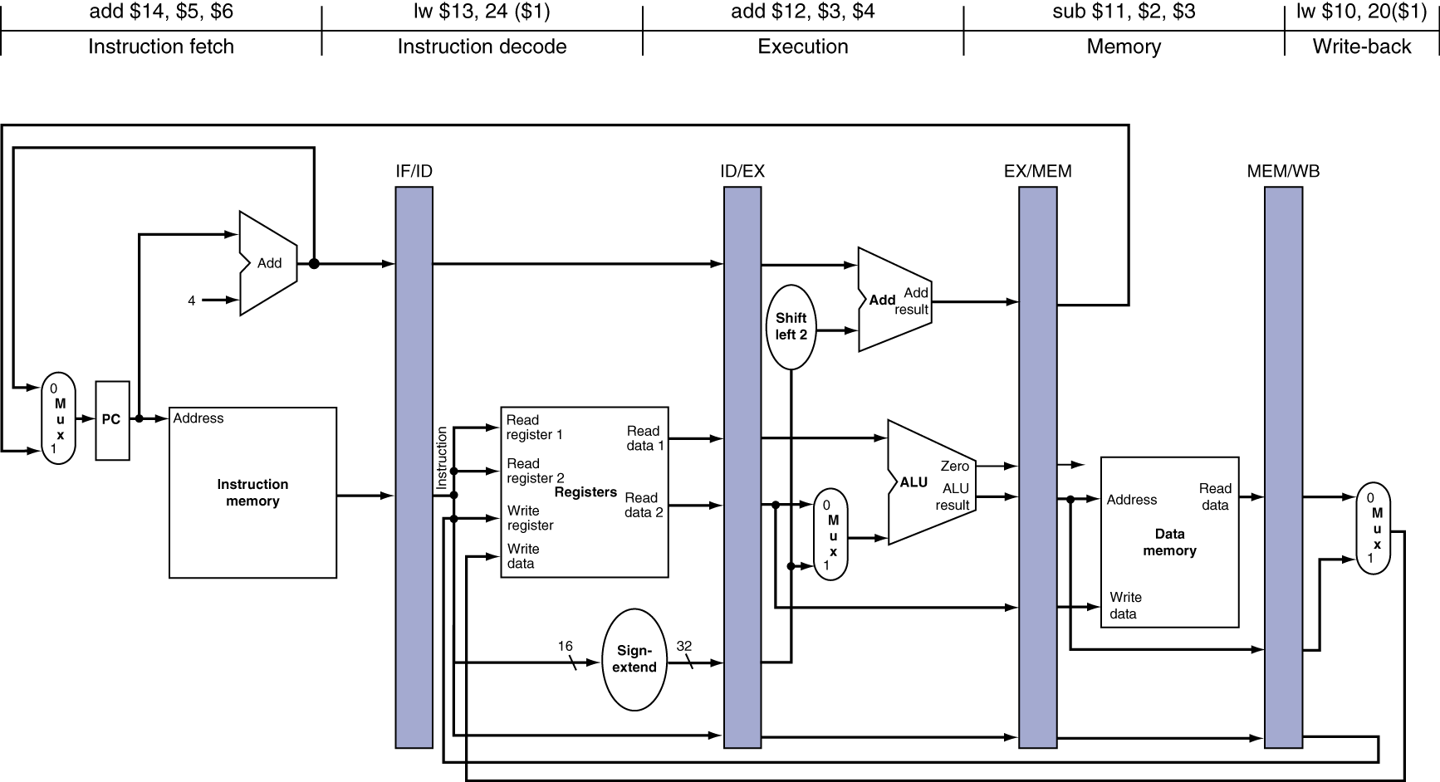
Single-Cycle Pipeline Diagram
State of pipeline in a given cycle
Chapter 4 — The Processor — <number>
Notes:
Morgan Kaufmann Publishers
Chapter 4 — The Processor

Slide 66
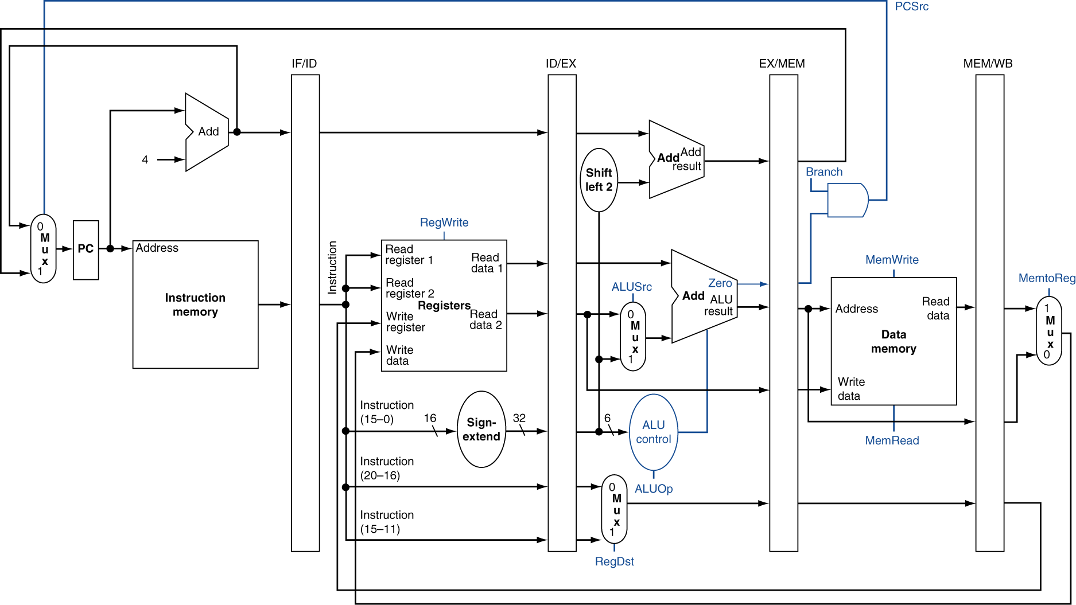
Pipelined Control (Simplified)
Chapter 4 — The Processor — <number>
Notes:
Morgan Kaufmann Publishers
Chapter 4 — The Processor

Slide 67
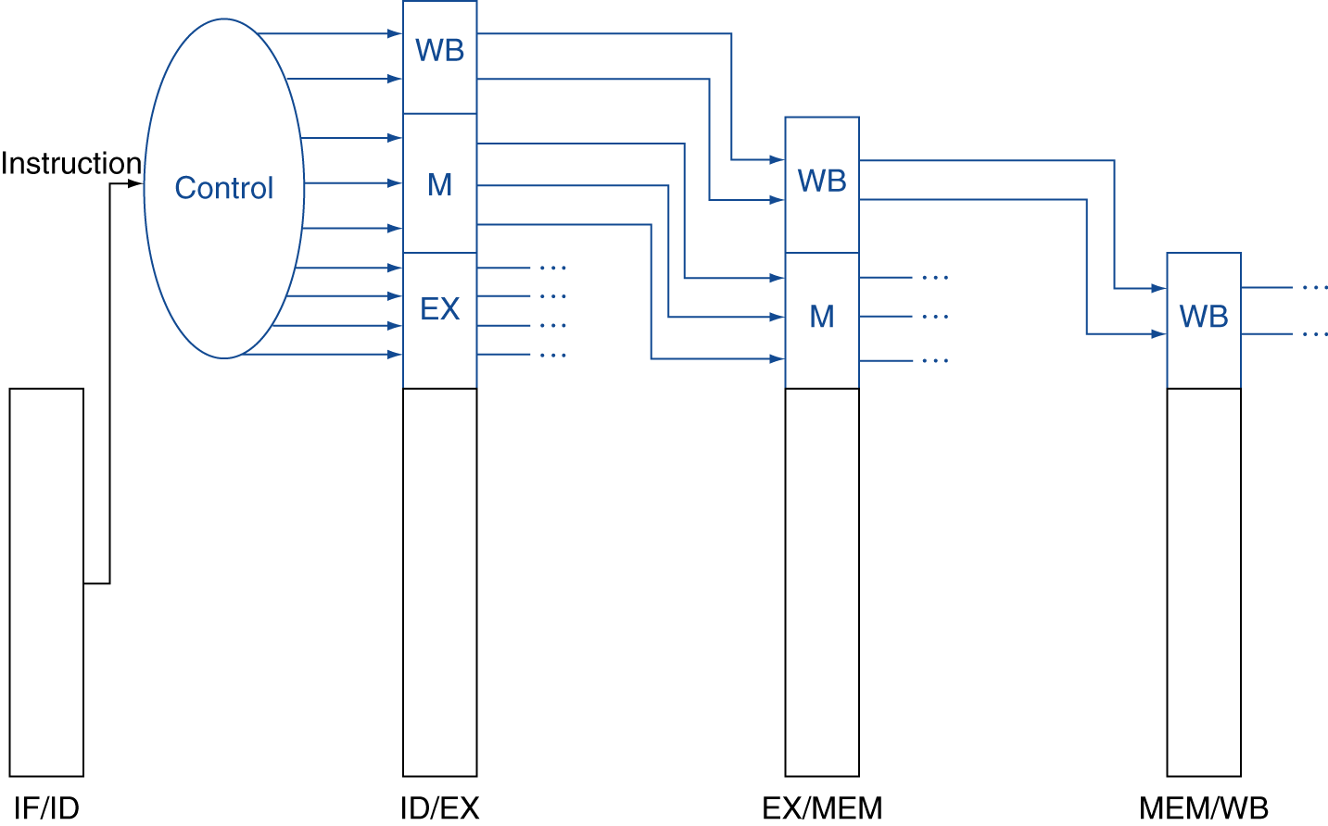
Pipelined Control
Control signals derived from instruction
Chapter 4 — The Processor — <number>
Notes:
Morgan Kaufmann Publishers
Chapter 4 — The Processor

Slide 68
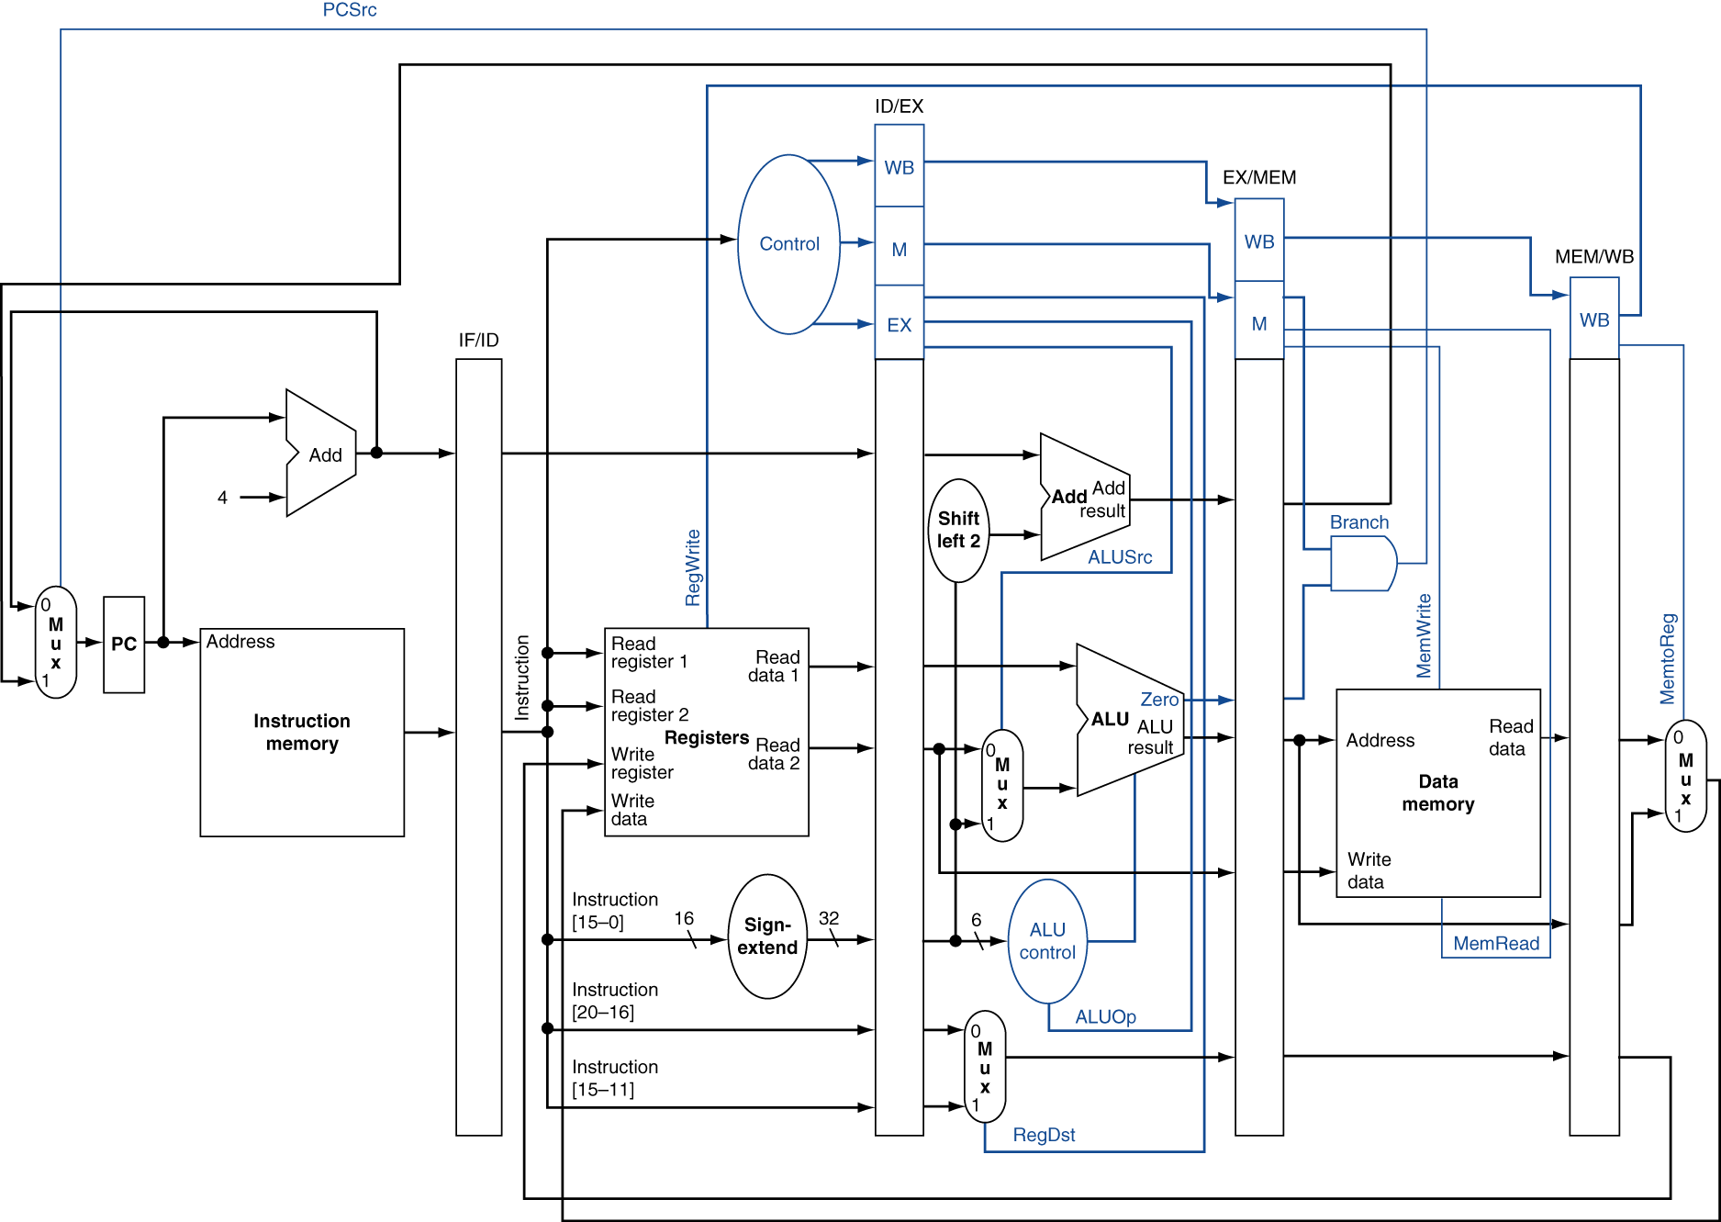
Pipelined Control
Chapter 4 — The Processor — <number>
Notes:
Morgan Kaufmann Publishers
Chapter 4 — The Processor

